Slide 1
Cornerstone City Church Peninsula Plus Community Hoo Are Ya
23rd March 2025

Slide 2
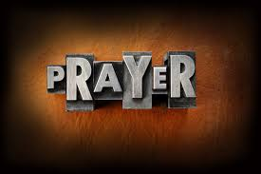

Slide 3
Isaiah 6:1 (NIV) In the year that King Uzziah died, I saw the Lord, high and exalted, seated on a throne; and the train of his robe filled the temple.

Slide 4
Isaiah 40:28-31 (NKJV) Have you not known? Have you not heard? The everlasting God, the Lord, The Creator of the ends of the earth, Neither faints nor is weary. His understanding is unsearchable. He gives power to the weak, And to those who have no might He increases strength.

Slide 5
Even the youths shall faint and be weary, And the young men shall utterly fall, But those who wait on the Lord Shall renew their strength; They shall mount up with wings like eagles, They shall run and not be weary, They shall walk and not faint..

Slide 6
Praise
CCLI Song # 7213077
© Brandon Lake MusicFor Humans PublishingMaverick City PublishingCapitol CMG GenesisCapitol CMG ParagonHousefires SoundsWriter's Roof PublishingMusic by Elevation Worship Publishing
For use solely with the SongSelect® Terms of Use. All rights reserved. www.ccli.com
Note: Reproduction of this sheet music requires a CCLI Music Reproduction Licence. Please report all copies.
CCLI Licence No. 33265

Slide 7
1/12
Let everything that has breath
Praise the Lord
Praise the Lord

Slide 8
2/12
I’ll praise in the valley
Praise on the mountain
I’ll praise when I’m sure
Praise when I’m doubting

Slide 9
3/12
I’ll praise when outnumbered
Praise when surrounded
'Cause praise is the water
My enemies drown in

Slide 10
4/12
As long as I’m breathing
I’ve got a reason to Praise the Lord oh my soul
Praise the Lord oh my soul

Slide 11
5/12
I’ll praise when I feel it
And I’ll praise when I don’t
I’ll praise 'cause I know
You’re still in control

Slide 12
6/12
'Cause my praise is a weapon
It’s more than a sound
My praise is the shout
That brings Jericho down

Slide 13
7/12
As long as I’m breathing
I’ve got a reason to Praise the Lord oh my soul
Praise the Lord oh my soul

Slide 14
8/12
I won’t be quiet
My God is alive
How could I keep it inside
Praise the Lord oh my soul

Slide 15
9/12
I’ll praise 'cause You’re sovereign
Praise 'cause You reign
Praise 'cause You rose and defeated the grave
I’ll praise 'cause You’re faithful
Praise 'cause You’re true
Praise 'cause there’s nobody greater than You

Slide 16
10/12
Praise the Lord oh my soul
Praise the Lord oh my soul
Praise the Lord oh my soul
Praise the Lord oh my soul
I won’t be quiet
My God is alive
How could I keep it inside

Slide 17
1 1/12
I won’t be quiet
My God is alive
How could I keep it inside
I won’t be quiet
My God is alive
How could I keep it inside
Praise the Lord oh my soul

Slide 18
12/12
Let everything that has breath
Praise the Lord
Praise the Lord

Slide 19
This Is Amazing Grace
CCLI Song # 6333821
Jeremy Riddle | Josh Farro | Phil Wickham
© 2012 WC Music Corp. (Admin. by / Small Stone Media BV, Holland (Admin. in the UK/Eire by Song Solutions www.songsolutions.org))
Bethel Music Publishing (Admin. by Song Solutions)
Phil Wickham Music (Admin. by Song Solutions www.songsolutions.org)
Seems Like Music (Admin. by Song Solutions www.songsolutions.org)
Sing My Songs (Admin. by Song Solutions www.songsolutions.org)
For use solely with the SongSelect® Terms of Use. All rights reserved. www.ccli.com
CCLI Licence No. 33265

Slide 20
1/8
Who breaks the power of sin and darkness
Whose love is mighty and so much stronger
The King of Glory the King above all kings

Slide 21
2/8
Who shakes the whole earth with holy thunder
And leaves us breathless in awe and wonder
The King of Glory the King above all kings

Slide 22
3/8
This is amazing grace
This is unfailing love
That You would take my place
That You would bear my cross
You laid down Your life
That I would be set free
Oh Jesus I sing for all that You've done for me

Slide 23
4/8
Who brings our chaos back into order
Who makes the orphan a son and daughter
The King of Glory the King of Glory

Slide 24
5/8
Who rules the nations with truth and justice
Shines like the sun in all of its brilliance
The King of Glory the King above all kings

Slide 25
6/8
This is amazing grace
This is unfailing love
That You would take my place
That You would bear my cross
You laid down Your life
That I would be set free
Oh Jesus I sing for all that You've done for me

Slide 26
7/8
Worthy is the Lamb who was slain
Worthy is the King who conquered the grave
Worthy is the Lamb who was slain
Worthy is the King who conquered the grave
Worthy is the Lamb who was slain
Worthy is the King who conquered the grave
Worthy is the Lamb who was slain
Worthy worthy worthy

Slide 27
8/8
This is amazing grace
This is unfailing love
That You would take my place
That You would bear my cross
You laid down Your life
That I would be set free
Oh Jesus I sing for all that You've done for me

Slide 29
Who You Say I am
CCLI Song # 7102401
Ben Fielding | Reuben Morgan
© 2017 Hillsong Music Publishing Australia
For use solely with the SongSelect® Terms of Use. All rights reserved. www.ccli.com
CCLI License # 33265

Slide 30
1/8
Who am I that the highest King
Would welcome me
I was lost but He brought me in
Oh His love for me
Oh His love for me

Slide 31
2/8
Who the Son sets free
Oh is free indeed
I'm a child of God
Yes I am

Slide 32
3/8
Free at last
He has ransomed me
His grace runs deep
While I was a slave to sin
Jesus died for me
Yes He died for me

Slide 33
4/8
Who the Son sets free
Oh is free indeed
I'm a child of God
Yes I am

Slide 34
5/8
In my Father's house
There's a place for me
I'm a child of God
Yes I am

Slide 35
6/8
I am chosen not forsaken
I am who You say I am
You are for me not against me
I am who You say I am

Slide 36
7/8
Who the Son sets free
Oh is free indeed
I'm a child of God
Yes I am

Slide 37
8/8
In my Father's house
There's a place for me
I'm a child of God
Yes I am

Slide 39
Goodness Of God
CCLI Song # 7117726
Ben Fielding | Brian Johnson | Ed Cash | Jason Ingram | Jenn Johnson
© 2018 Capitol CMG Paragon (Admin. by Capitol CMG Publishing)
Fellow Ships Music (Admin. by Essential Music Publishing LLC)
So Essential Tunes (Admin. by Essential Music Publishing LLC)
SHOUT! Music Publishing Australia (Admin. by SHOUT! Music Publishing UK)
Bethel Music Publishing (Admin. by Song Solutions)
For use solely with the SongSelect® Terms of Use. All rights reserved. www.ccli.com
CCLI Licence No. 33265

Slide 40
1/6
I love You Lord
Oh Your mercy never fails me
All my days
I've been held in Your hands
From the moment that I wake up
Until I lay my head
I will sing of the goodness of God

Slide 41
2/6
All my life You have been faithful
All my life You have been so so good
With every breath that I am able
I will sing of the goodness of God

Slide 42
3/6
I love Your voice
You have led me through the fire
In darkest night
You are close like no other
I've known You as a father
I've known You as a friend
I have lived in the goodness of God

Slide 43
4/6
All my life You have been faithful
All my life You have been so so good
With every breath that I am able
I will sing of the goodness of God

Slide 44
5/6
Your goodness is running after
It’s running after me
(REPEAT)
With my life laid down
I’m surrendered now
I give You everything
Your goodness is running after
It's running after me

Slide 45
6/6
All my life You have been faithful
All my life You have been so so good
With every breath that I am able
I will sing of the goodness of God

Slide 47
Worthy Of it All
CCLI Song # 6280644
David Brymer | Ryan Hall
© 2012 Common Hymnal Publishing (Admin. by Integrity Music Ltd)
Innerland (Admin. by Integrity Music Ltd)
Underground Treasure (Admin. by Integrity Music Ltd)
Wayfinder Music (Admin. by Integrity Music Ltd)
For use solely with the SongSelect® Terms of Use. All rights reserved. www.ccli.com
CCLI Licence No. 33265

Slide 48
1/4
All the saints and angels
Bow before Your throne
All the elders cast their crowns
Before the Lamb of God and sing

Slide 49
2/4
You are worthy of it all
You are worthy of it all
For from You are all things
And to You are all things
You deserve the glory

Slide 50
3/4
Day and night,
Night and day,
Let incense arise
(X4)
Day and night
Night and day

Slide 51
4/4
You are worthy of it all
You are worthy of it all
For from You are all things
And to You are all things
You deserve the glory

Slide 53


Slide 54


Slide 55
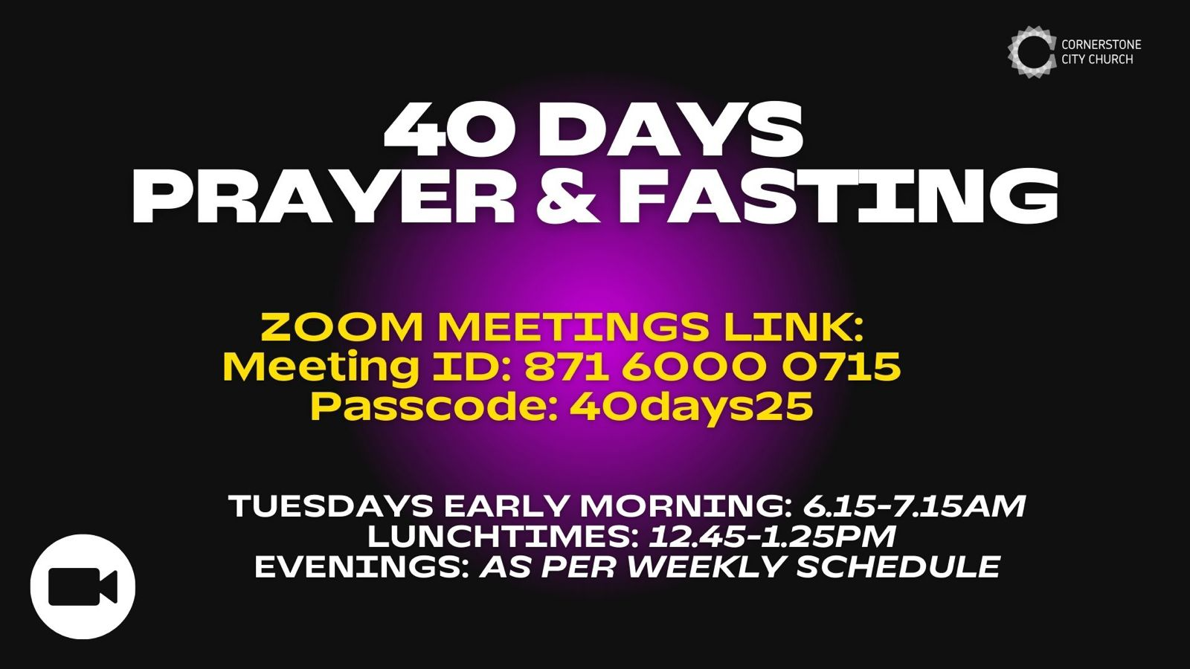

Slide 56
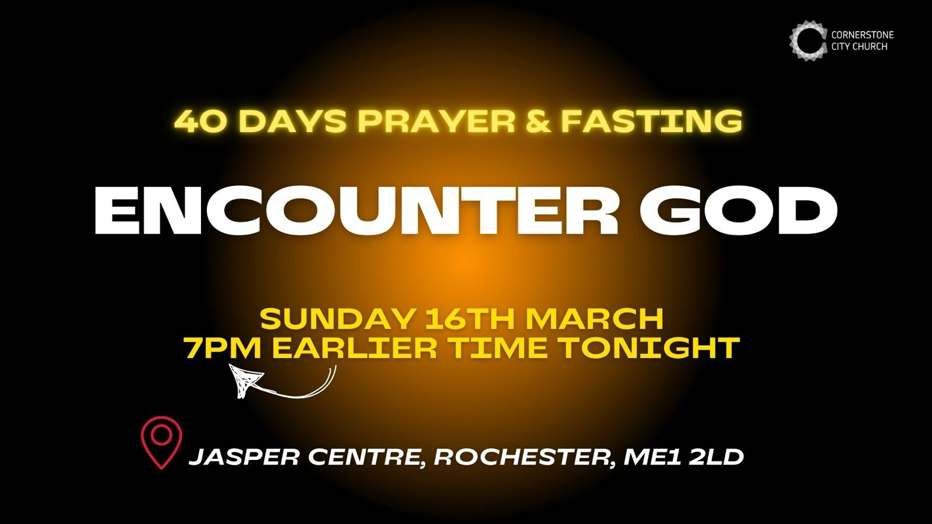

Slide 57


Slide 58
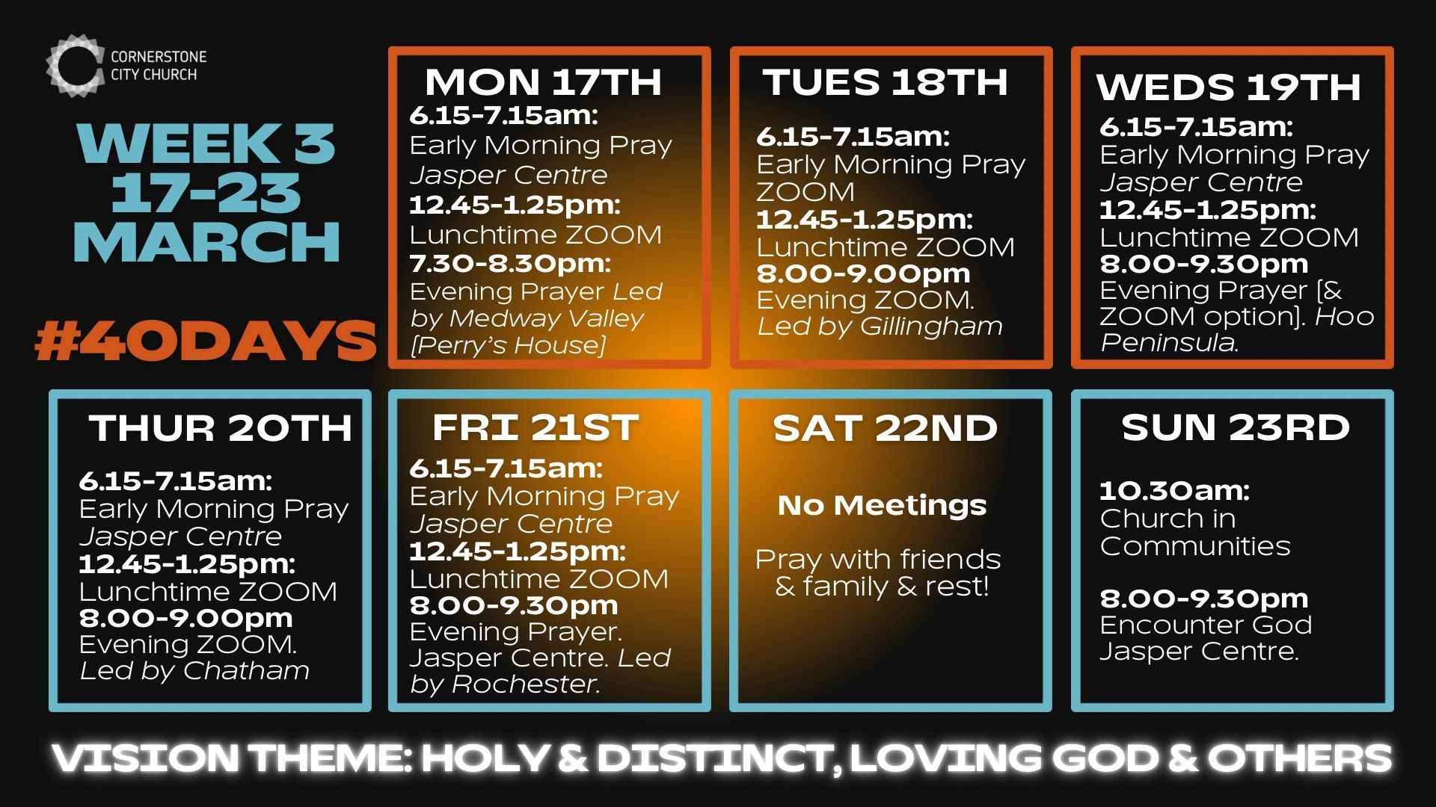

Slide 59
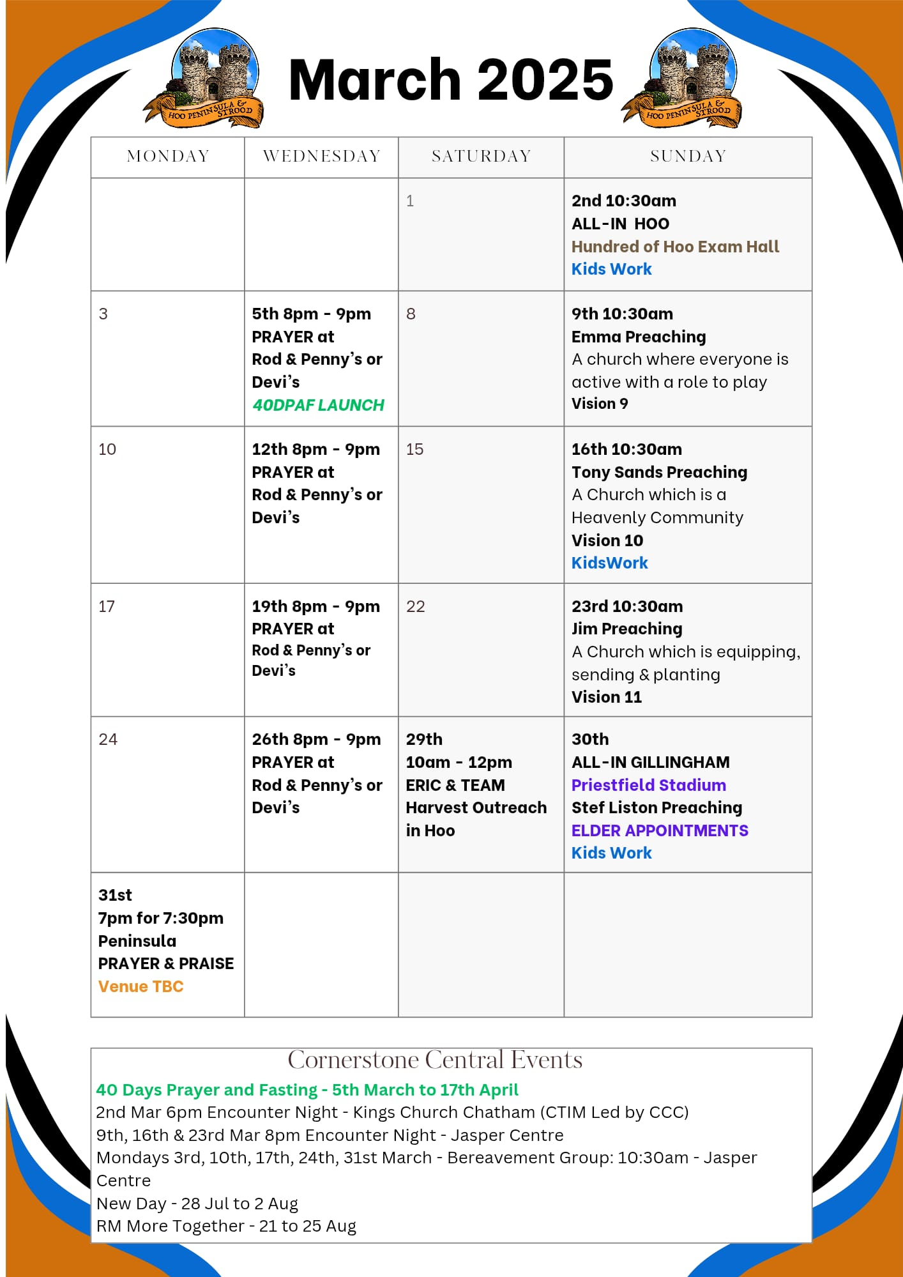

Slide 60

Grow Group 1
Grow Group 1 Name: On YOUR MARK!

Slide 61
Leaders
Leaderss
Phil & Kim
Maria (Mia) Warren
Matthew Harrison
Richard & Elisha Acheampong
Phil & Kim
Maria (Mia) Warren
Matthew Harrison
Richard & Elisa Acheampong

Slide 62
Q1 into Q2 Meeting Dates
Q1 into Q2 Meeting Dates
Month | Date / Day | Host
January | Saturday 11th | Maria
 | Wednesday 22nd | Maria
February | Saturday 8th | Venue Needed
 | Wednesday 19th | Phil & Kim
March | Saturday 8th | Richard & Elisha
 | Wednesday 19th | Venue Needed
April | Saturday 12th | Matt
 | Wednesday 30th | Venue Needed

Slide 63
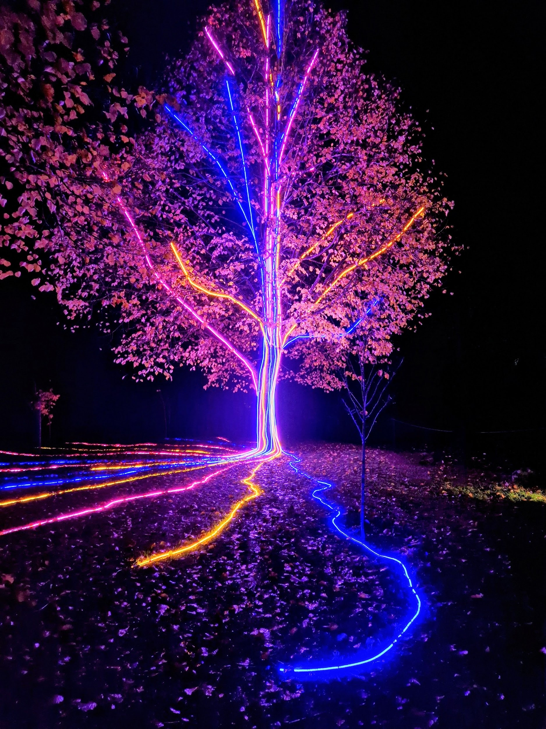
Storm Walker
Storm Walker
Symbolising, trust in Jesus Christ through life's storms.
Mark 4:35-41

Slide 64
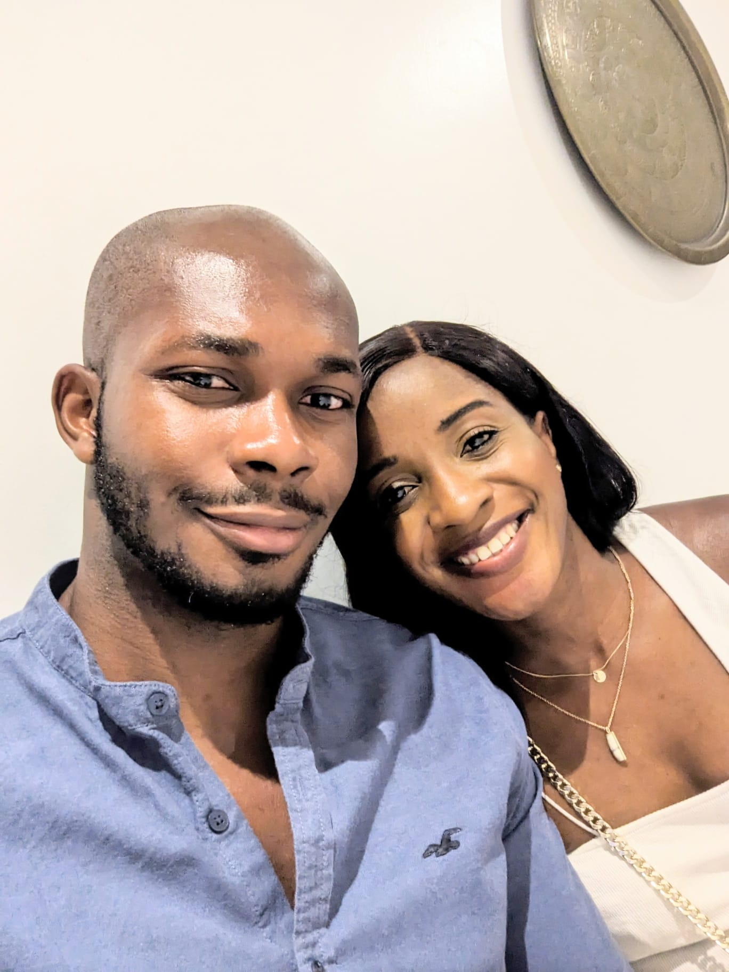


Group Leaders
Micheal and Mwamba
Wilfred and Parveen
Hannah

Slide 65
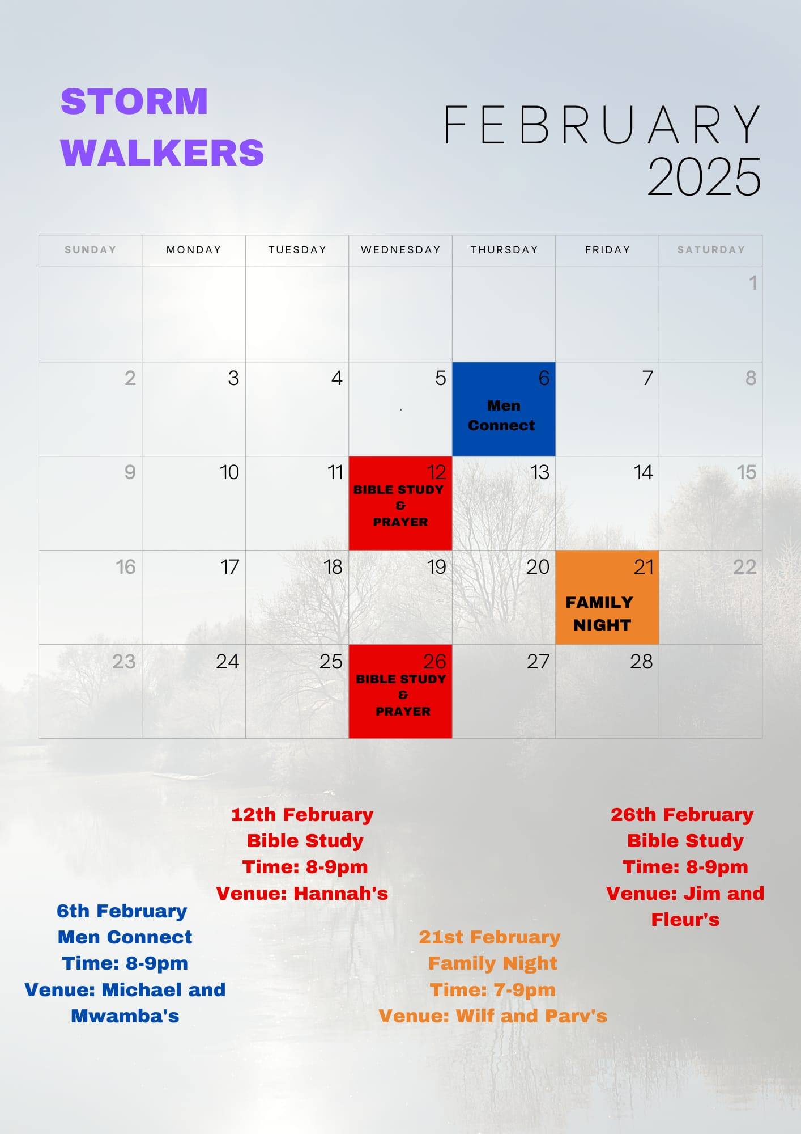

Slide 66


Slide 67
2 Corinthians 14 May the grace of the Lord Jesus Christ, and the love of God, and the fellowship of the Holy Spirit be with you all
Surely goodness and mercy shall follow me all the days of my life, and I shall dwell in the house of the Lord forever.

